Slide 1
Model Fitting: Line and Circle Detection
Alessandro Giusti
Slides in part adapted from Erkut Erdem https://web.cs.hacettepe.edu.tr/~erkut and various other authors credited on individual slides

Slide 2
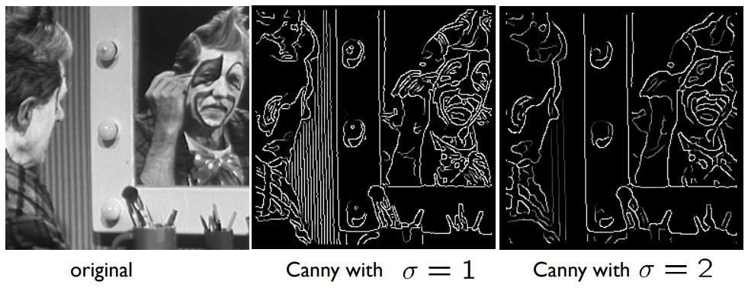
Edges are a local, low-level feature
Today: how to extract higher-level information (“boundaries”)
Boundaries are composed by groups of edge pixels

Slide 3
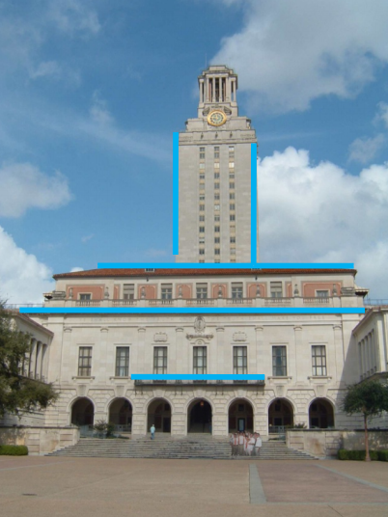
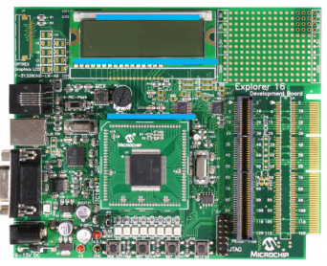
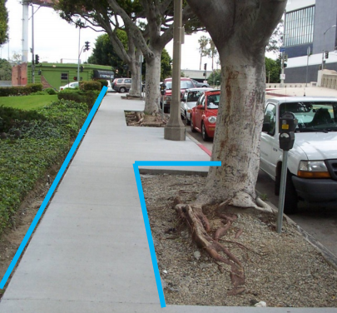
Lines are ubiquitous in man-made scenes
Slide credit: K. Grauman

Slide 4
Why is edge detection not enough?
Usually, more than one line in an image
Many edge pixels not belonging to any line (clutter)
Edge pixels belonging to a line might not be perfectly aligned (noise)
Lines sometimes incomplete
Which pixels go with which line?

Slide 5
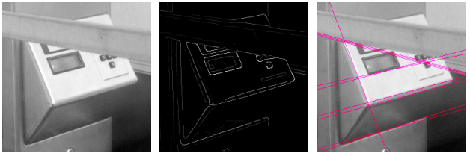
What is model fitting?
Observations: many low-level features
Model fitting: find (fit) an high-level explanation (model) that well explains the observations
In our case:
observations: edges
model: one or more lines
Slide credit: K. Grauman

Slide 6
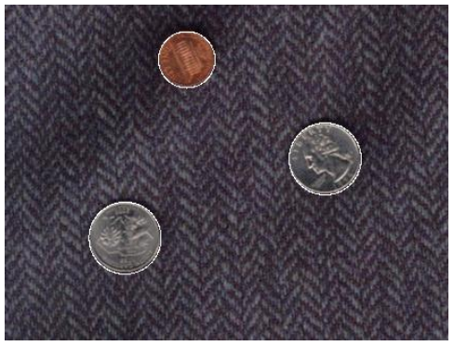
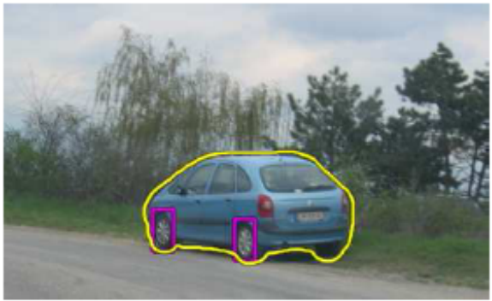
Other examples of model fitting
Find edges then identify circles
Find objects with known silhouette
Slide credit: K. Grauman

Slide 7
Voting algorithms (a general technique)
Every feature casts votes for all models that are compatible with it
We choose models that accumulated a lot of votes
What about the votes cast by clutter and noise?
Their votes might be many but will be inconsistent!
Instead, features belonging to a model will concentrate a lot of votes for that model

Slide 8
The Hough Transform: a voting algorithm for finding lines
Every edge point casts votes for all lines that are compatible with it
We choose lines that accumulated a lot of votes

Slide 9
Part 1: the Hough Algorithm for line fitting

Slide 10
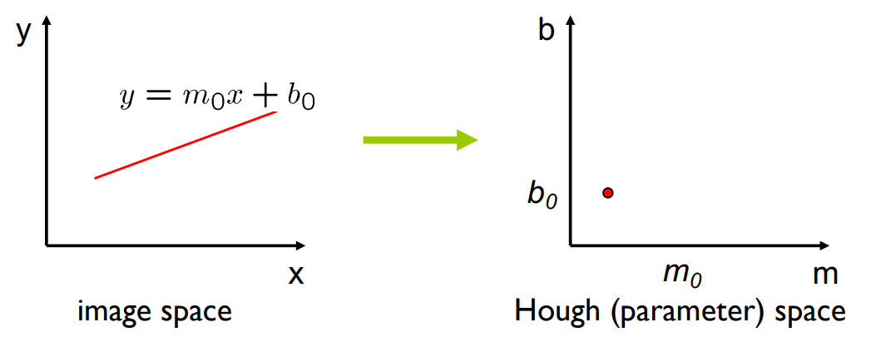
How to represent a line?
A line in the image corresponds to a point in Hough space
Slide credit: S. Seitz

Slide 11
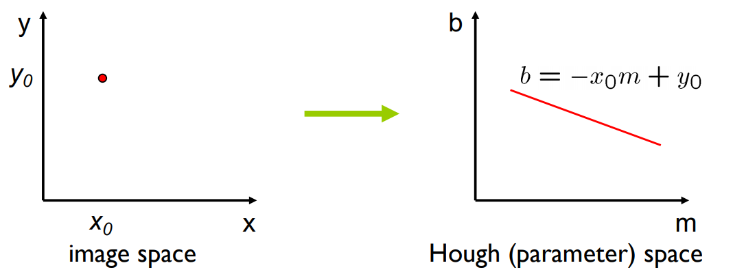
What does a point correspond to?
?
A point in the image corresponds to a line in Hough space
Slide credit: S. Seitz

Slide 12
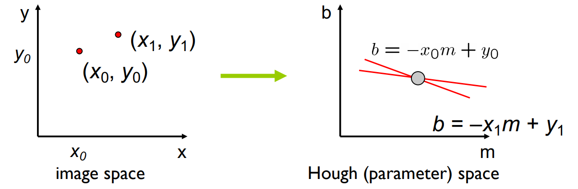
Finding a line through two points
What are the line parameters for the line that contains both (x0, y0) and (x1, y1)?
The (m,b) coordinates of the intersection of the hough-space lines
b = –x₀m + y₀ and b = –x₁m + y₁
Slide credit: K. Grauman

Slide 13
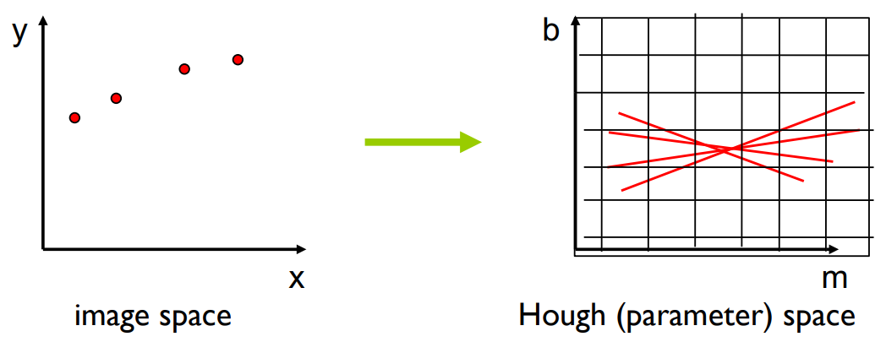
Finding a line through many points
?
Note that the 4 points are not exactly aligned: in Hough space, the lines corresponding to each point will almost intersect.
Now, let each edge point in image space vote for a set of possible parameters in Hough space.
Accumulate votes in a discrete set of bins; parameters with the most votes indicate a line in image space.
Slide credit: K. Grauman

Slide 14

Where is the problem with this approach?
The (m,b) parameter space is not bounded
We can not represent vertical lines

Slide 15
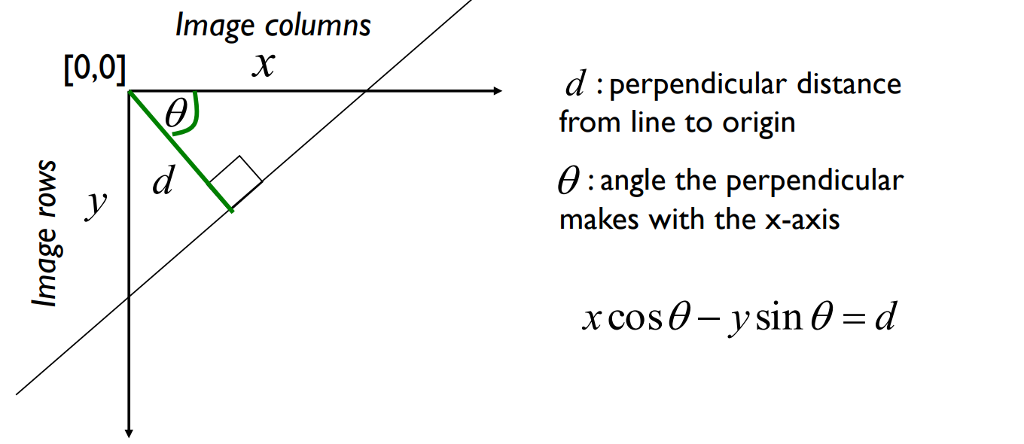
Solution: represent lines in polar coordinates
The hough space is now (d,θ) instead of (m,b)
Same as before: a line in image space is a point in Hough space.
Slide credit: K. Grauman

Slide 16
Pause and ponder
For an image of size (width, height). What are the boundaries of the Hough space such that we can represent any line overlapping the image?
Given a point in image space, what is the corresponding shape in Hough space?
(solution: a sinusoid)
Slide credit: K. Grauman

Slide 17
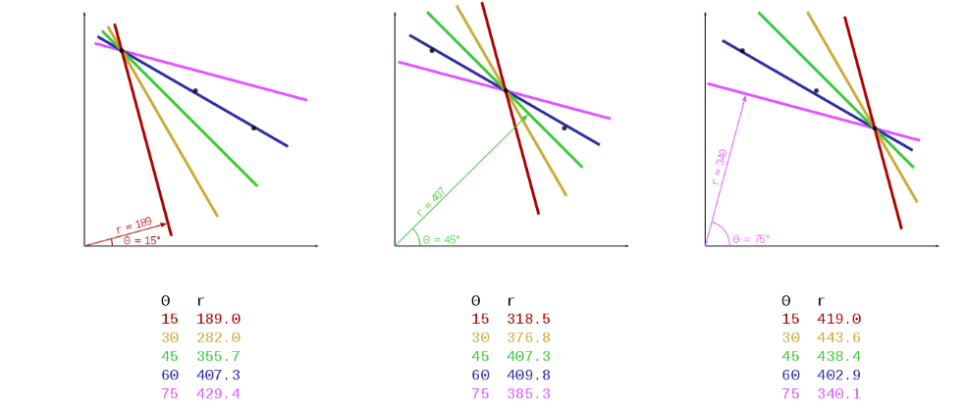
An example
Given 3 points in image space, here are some of the corresponding points in hough space
Image credit Derfopps [CC BY 4.0], via Wikimedia Commons

Slide 18
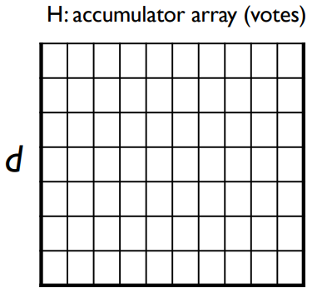
Hough Transform: the algorithm
Initialize H[d,θ]=0
for each edge point (x,y) in the image:
for θ in range(θmin,θmax):
d = x cos(θ) - y sin(θ)
H[d,θ]+=1
Find the value(s) of (d,θ) where H[d,θ] is maximum
The detected line in the image is given by d = x cos(θ) - y sin(θ)
Slide credit: S. Seitz

Slide 19
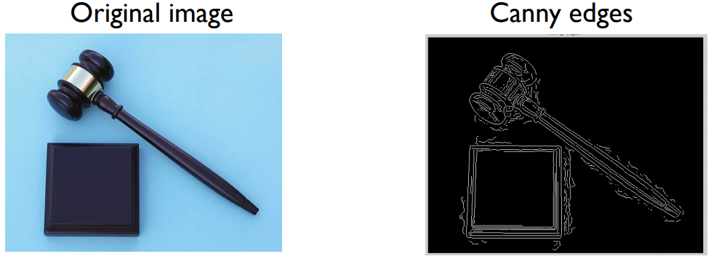
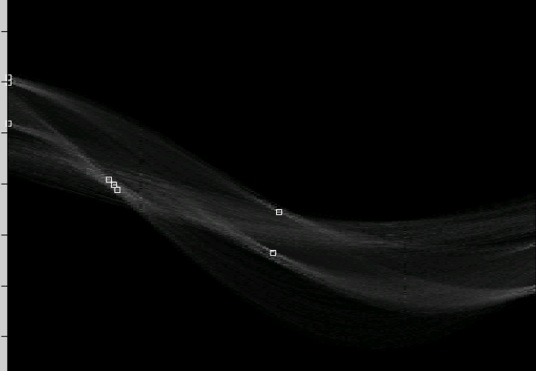
Quiz: identify which maxima represent the four lines of the square object!
-600
d
0
+600
-90
0
+90
θ
Slide credit: K. Grauman

Slide 20
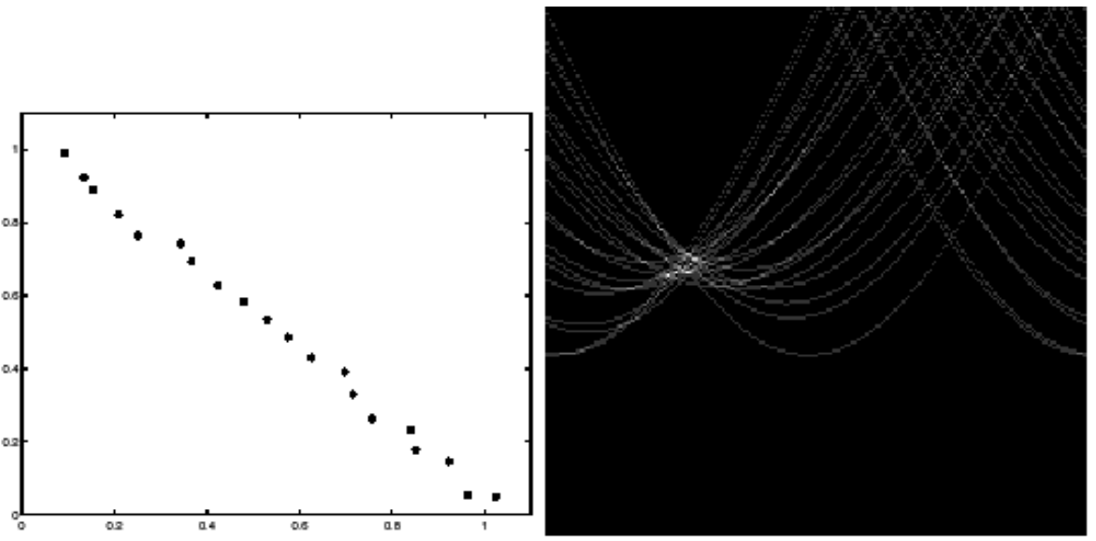
What’s the effect of noise?
H: accumulator array
Image space
y
d
many weak peaks
x
θ
Slide credit: K. Grauman

Slide 21
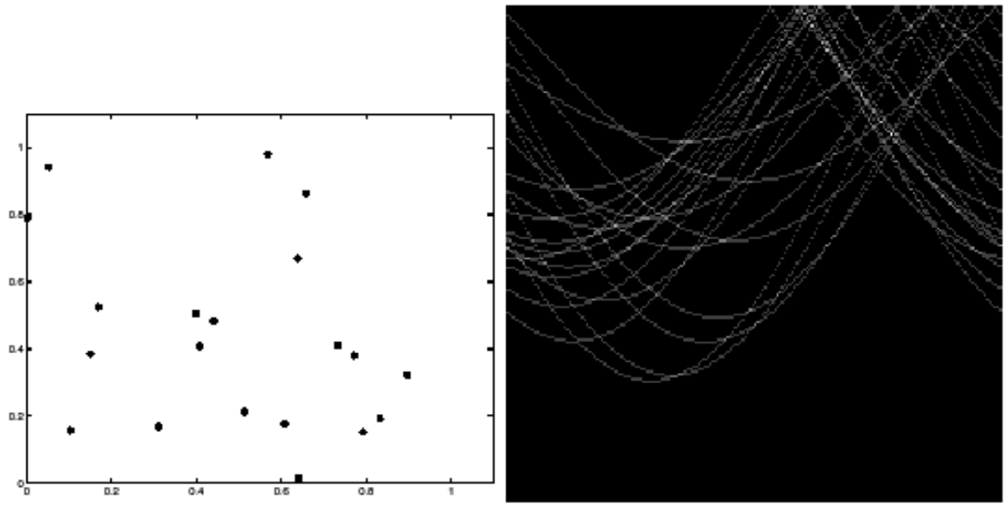
What’s the effect of noise?
H: accumulator array
Image space
y
d
x
θ
Slide credit: K. Grauman

Slide 22
Bin size in the accumulator: an important parameter
How large are the bins in the accumulator?
Too small:
many weak peaks due to noise
Just right:
one strong peak per line, despite noise
Too large:
poor accuracy in locating the line
many votes from clutter might end up in the same bin
A solution:
keep bin size small but also vote for neighbors in the accumulator
(this is the same as “smoothing” the accumulator image)

Slide 23
Extension 1
From the edge detection algorithm, we know the direction of the gradient for each edge pixel
Remember how that was related to edge direction?
Edge direction is orthogonal to gradient direction
We can make sure an edge pixel only votes for lines that have (almost) the direction of the edge!
reduces the computation time
reduces the number of useless votes (better visibility of maxima corresponding to real lines)

Slide 24
Extension 2
Keep track of edge points that voted for each line.
If a line is chosen, look for groups of edge points that voted for that line → find start point and end point of segment.

Slide 25
Part 2: the Hough algorithm for circle detection

Slide 26
The Hough Transform: a voting algorithm…
Every feature casts votes for all models that are compatible with it
We choose models that accumulated a lot of votes
Every edge point casts votes for all circles that are compatible with it
We choose circles that accumulated a lot of votes

Slide 27
The Hough Transform: a voting algorithm… for finding lines
Every edge point casts votes for all lines that are compatible with it
We choose lines that accumulated a lot of votes

Slide 28
The Hough Transform: a voting algorithm… for finding circles
Every edge point casts votes for all circles that are compatible with it
We choose circles that accumulated a lot of votes

Slide 29
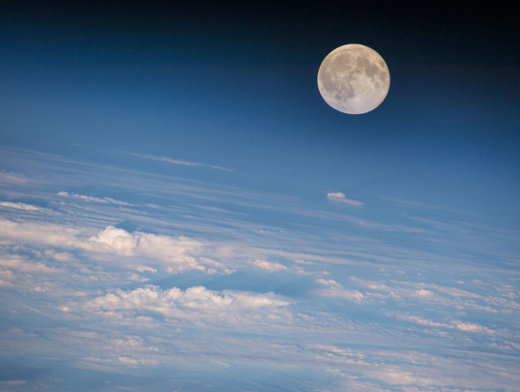
How many variables do I need to uniquely define a circle?

Slide 30
3 parameters uniquely define a circle
→ You use a 3-dimensional Hough Space
Center x
Center y
Radius

Slide 31
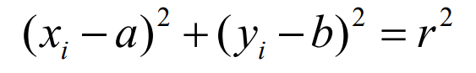
How do we parametrize circles?
Center (x=a,y=b) and radius r
3 degrees of freedom (a, b and r)
If we assume known radius (fix r)
Hough space is 2D:
a: x coordinate of circle center
b: y coordinate of circle center
One point in image space maps to... a circle in hough space

Slide 32
Hough space for circles with known radius
Image space
Hough space (2D)
y
b
x
a
Most votes happen here

Slide 33
Hough space for circles with unknown radius
Image space
Hough space
y
b
x
a

Slide 34
Hough space for circles with unknown radius
Image space
Hough space
y
x
b
a

Slide 35
Hough space for circles with unknown radius
Image space
Hough space (3D)
r
y
x
b
a

Slide 36
Hough space for circles with unknown radius
Image space
Hough space
r
y
r = 0
x
b
a

Slide 37
Hough space for circles with unknown radius
Image space
Hough space
r
y
r = 1
x
b
a

Slide 38
Hough space for circles with unknown radius
Image space
Hough space
r
y
r = 2
x
b
a

Slide 39
Hough space for circles with unknown radius
Image space
Hough space
r
y
x

Slide 40
Hough space for circles with unknown radius
Image space
Hough space
r
y
x

Slide 41
Hough space for circles with unknown radius
Image space
Hough space
r
y
x

Slide 42
Algorithm
Initialize H accumulator to zeros
For every edge pixel (x,y):
For each possible radius value r:
For each possible direction θ:
a = x – r cos(θ) // column
b = y + r sin(θ) // row
H[a,b,r] += 1

Slide 43
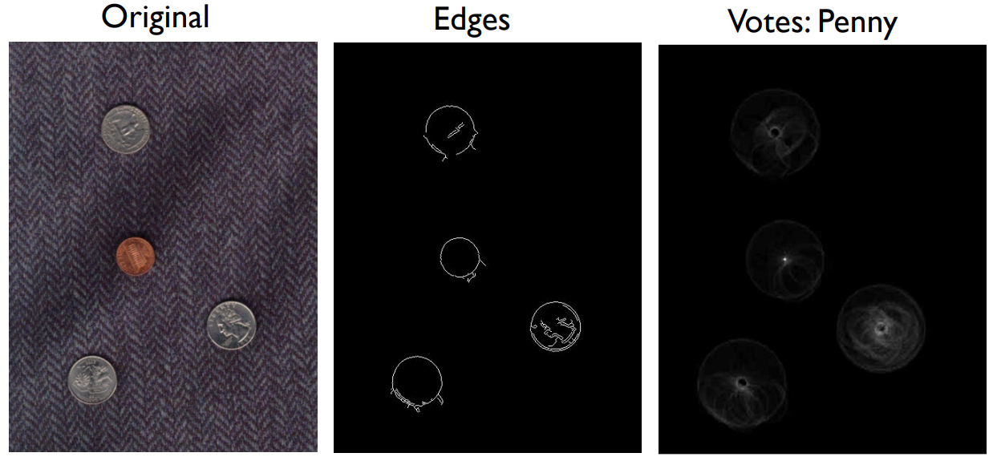
An example
Slide credit: K. Grauman
Accumulator for radius equal to radius of a penny
Image
Edges
Accumulator for radius=penny
maximum

Slide 44
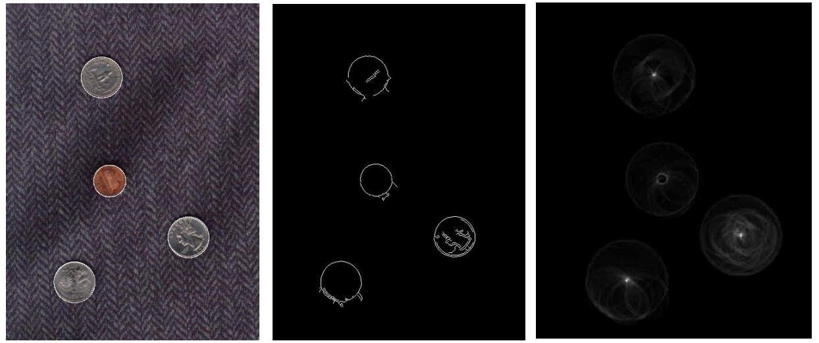
An example
Slide credit: K. Grauman
Accumulator for radius equal to radius of a quarter
Image
Edges
Accumulator for radius=quarter
not a maximum

Slide 45
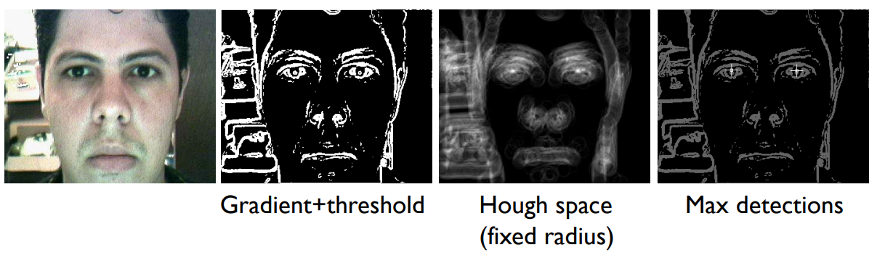
Iris detection
Hemerson Pistori and Eduardo Rocha Costa http://rsbweb.nih.gov/ij/plugins/hough-circles.html

Slide 46
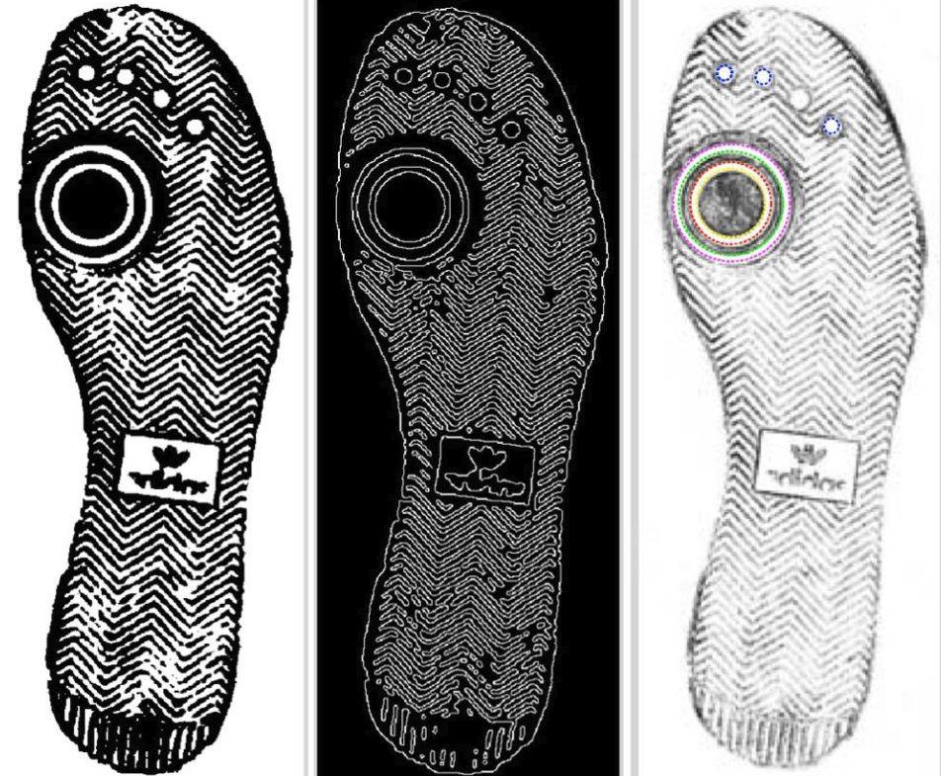
Image credit Wikimedia user 1w2w3y [CC BY-SA 4.0]

Slide 47
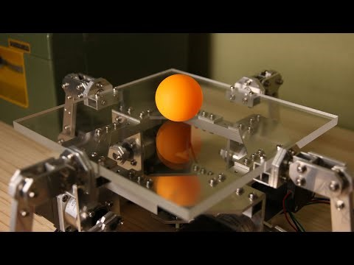
An application to robotics
https://www.youtube.com/watch?v=lYyAMDYzJQM

Slide 48
Part 3: Extensions and conclusions

Slide 49
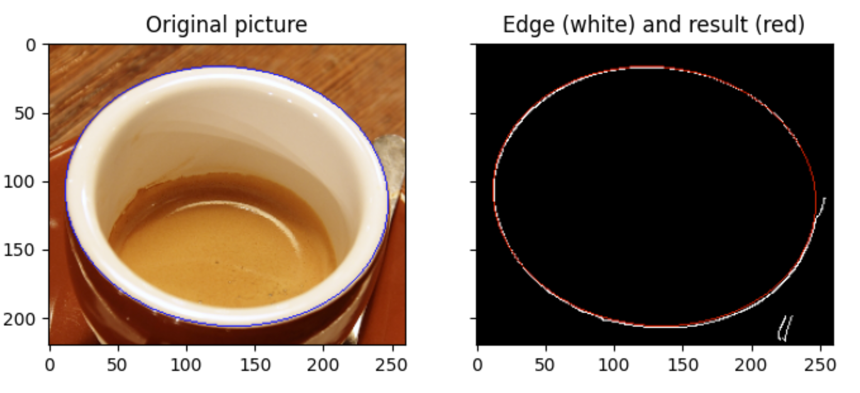
Detecting ellipses
https://scikit-image.org/docs/dev/auto_examples/edges/plot_circular_elliptical_hough_transform.html

Slide 50
Quiz
How many parameters are needed to define a generic ellipse in 2D?

Slide 51
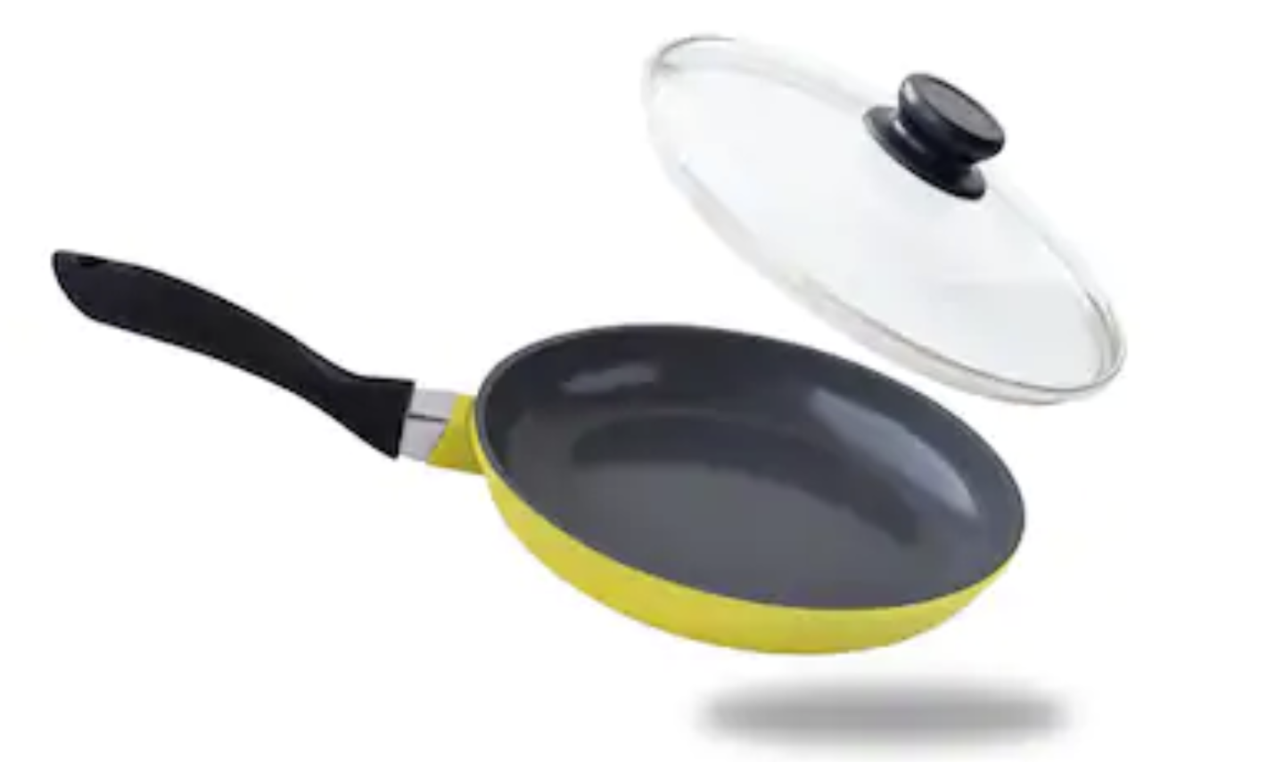
Try to fit an ellipse in powerpoint

Slide 52
5 parameters uniquely define an ellipse
→ You use a 5-dimensional Hough Space
Center x
Center y
Radius
Eccentricity (how squished?)
Angle

Slide 53
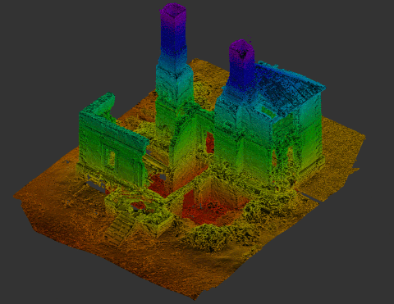
Finding 3D planes in point clouds

Slide 54
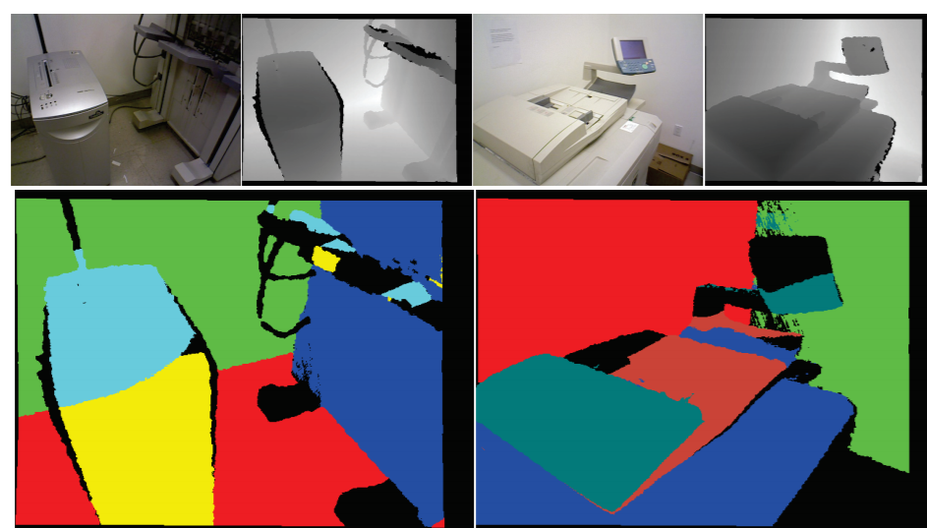
Finding 3D planes in point clouds
https://www.visgraf.impa.br/Data/RefBib/PS_PDF/prl2018/Vera2018.pdf

Slide 55
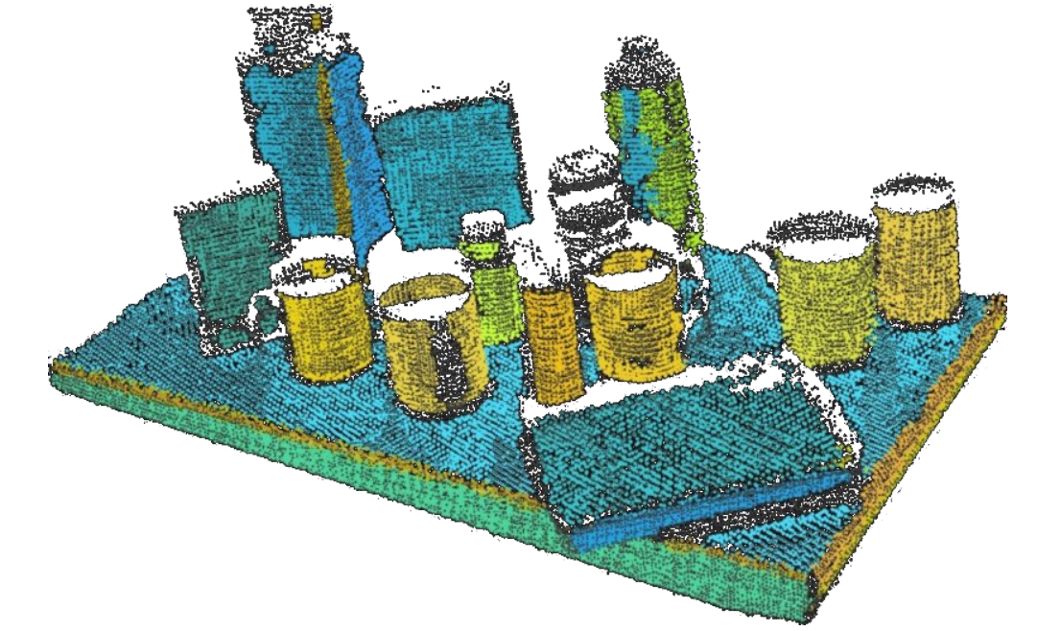
Finding planes and cylinders in point cloud data
How many parameters are needed to define a plane in 3D?

Slide 56
Voting Algorithms for Model Fitting - Conclusions
A family of powerful algorithms based on a simple concept
Advantages
All points are processed independently, so the algorithm can cope with occlusions and gaps
Voting algorithms are robust to clutter, because points not corresponding to any model are unlikely to contribute consistently to any single bin
Can detect multiple instances of a model in a single pass
Disadvantages
Only suitable for models with few parameters
Must filter out spurious peaks in hough accumulator
Quantization of Hough space is tricky

